Slide 1
Tres Hombres Enojados
Salmos 37:7-8
Notes:
Psalms 37:7-8 KJV Rest in the LORD, and wait patiently for him: fret not thyself because of him who prospereth in his way, because of the man who bringeth wicked devices to pass. (8) Cease from anger, and forsake wrath: fret not thyself in any wise to do evil.

Slide 2
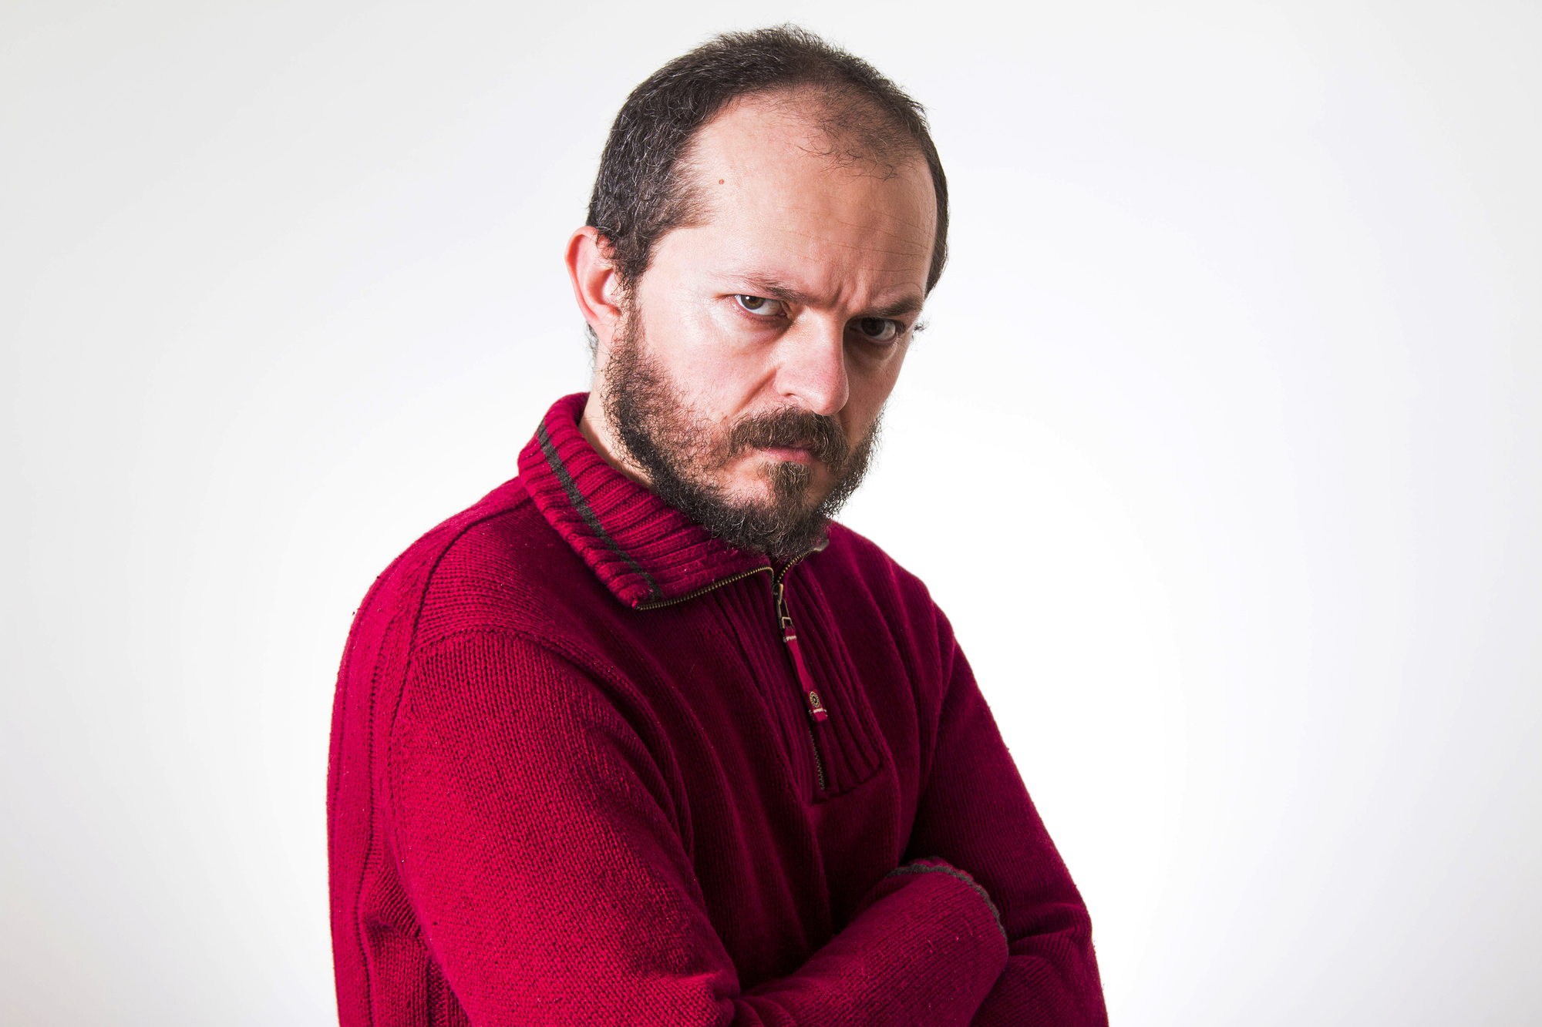
¿La Sabiduría De La Ira?
Proverbios 10:12
Proverbios 11:23
Proverbios 12:16
Proverbios 14:29
Proverbios 15:1
Proverbios 15:17-18
Proverbios 16:32
Proverbios 19:11
Proverbios 19:19
Proverbios 21:24
Proverbios 22:24-25
Proverbios 27:3-4
Notes:
Proverbs 10:12 KJV Hatred stirreth up strifes: but love covereth all sins.
Proverbs 11:23 CEV Good people want what is best, but troublemakers hope to stir up trouble.
Proverbs 12:16 CEV Losing your temper is foolish; ignoring an insult is smart.
Proverbs 14:29 CEV It's smart to be patient, but it's stupid to lose your temper.
Proverbs 15:1 KJV A soft answer turneth away wrath: but grievous words stir up anger.
Proverbs 15:17-18 KJV Better is a dinner of herbs where love is, than a stalled ox and hatred therewith. (18) A wrathful man stirreth up strife: but he that is slow to anger appeaseth strife.
Proverbs 16:32 KJV He that is slow to anger is better than the mighty; and he that ruleth his spirit than he that taketh a city.
Proverbs 19:11 KJV The discretion of a man deferreth his anger; and it is his glory to pass over a transgression.
Proverbs 19:19 KJV A man of great wrath shall suffer punishment: for if thou deliver him, yet thou must do it again.
Proverbs 21:24 NIV The proud and arrogant person--"Mocker" is his name-- behaves with insolent fury.
Proverbs 22:24-25 KJV Make no friendship with an angry man; and with a furious man thou shalt not go: (25) Lest thou learn his ways, and get a snare to thy soul.
Proverbs 27:3-4 KJV A stone is heavy, and the sand weighty; but a fool's wrath is heavier than them both. (4) Wrath is cruel, and anger is outrageous; but who is able to stand before envy?

Slide 3
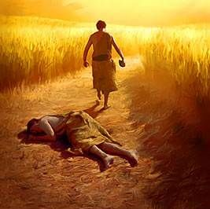
La ira de Caín
Génesis 4: 1-12
¿Por qué estás enojado?
Envidia
Resentimiento
Malicia
Amargura
Ira hacia tu familia
Ira hacia tu familia espiritual
1 juan 3: 11-12
Judas 1: 8-11
Notes:
Genesis 4:1-12 KJV And Adam knew Eve his wife; and she conceived, and bare Cain, and said, I have gotten a man from the LORD. (2) And she again bare his brother Abel. And Abel was a keeper of sheep, but Cain was a tiller of the ground. (3) And in process of time it came to pass, that Cain brought of the fruit of the ground an offering unto the LORD. (4) And Abel, he also brought of the firstlings of his flock and of the fat thereof. And the LORD had respect unto Abel and to his offering: (5) But unto Cain and to his offering he had not respect. And Cain was very wroth, and his countenance fell. (6) And the LORD said unto Cain, Why art thou wroth? and why is thy countenance fallen? (7) If thou doest well, shalt thou not be accepted? and if thou doest not well, sin lieth at the door. And unto thee shall be his desire, and thou shalt rule over him. (8) And Cain talked with Abel his brother: and it came to pass, when they were in the field, that Cain rose up against Abel his brother, and slew him. (9) And the LORD said unto Cain, Where is Abel thy brother? And he said, I know not: Am I my brother's keeper? (10) And he said, What hast thou done? the voice of thy brother's blood crieth unto me from the ground. (11) And now art thou cursed from the earth, which hath opened her mouth to receive thy brother's blood from thy hand; (12) When thou tillest the ground, it shall not henceforth yield unto thee her strength; a fugitive and a vagabond shalt thou be in the earth.
1 John 3:11-21 KJV For this is the message that ye heard from the beginning, that we should love one another. (12) Not as Cain, who was of that wicked one, and slew his brother. And wherefore slew he him? Because his own works were evil, and his brother's righteous. (13) Marvel not, my brethren, if the world hate you. (14) We know that we have passed from death unto life, because we love the brethren. He that loveth not his brother abideth in death. (15) Whosoever hateth his brother is a murderer: and ye know that no murderer hath eternal life abiding in him. (16) Hereby perceive we the love of God, because he laid down his life for us: and we ought to lay down our lives for the brethren. (17) But whoso hath this world's good, and seeth his brother have need, and shutteth up his bowels of compassion from him, how dwelleth the love of God in him? (18) My little children, let us not love in word, neither in tongue; but in deed and in truth. (19) And hereby we know that we are of the truth, and shall assure our hearts before him. (20) For if our heart condemn us, God is greater than our heart, and knoweth all things. (21) Beloved, if our heart condemn us not, then have we confidence toward God.
Jude 1:8-11 KJV Likewise also these filthy dreamers defile the flesh, despise dominion, and speak evil of dignities. (9) Yet Michael the archangel, when contending with the devil he disputed about the body of Moses, durst not bring against him a railing accusation, but said, The Lord rebuke thee. (10) But these speak evil of those things which they know not: but what they know naturally, as brute beasts, in those things they corrupt themselves. (11) Woe unto them! for they have gone in the way of Cain, and ran greedily after the error of Balaam for reward, and perished in the gainsaying of Core.

Slide 4
La Ira
De JONAS
Jon 4:1-11
Notes:
Jonah 4:1-11 ESV But it displeased Jonah exceedingly, and he was angry. (2) And he prayed to the LORD and said, "O LORD, is not this what I said when I was yet in my country? That is why I made haste to flee to Tarshish; for I knew that you are a gracious God and merciful, slow to anger and abounding in steadfast love, and relenting from disaster. (3) Therefore now, O LORD, please take my life from me, for it is better for me to die than to live." (4) And the LORD said, "Do you do well to be angry?" (5) Jonah went out of the city and sat to the east of the city and made a booth for himself there. He sat under it in the shade, till he should see what would become of the city. (6) Now the LORD God appointed a plant and made it come up over Jonah, that it might be a shade over his head, to save him from his discomfort. So Jonah was exceedingly glad because of the plant. (7) But when dawn came up the next day, God appointed a worm that attacked the plant, so that it withered. (8) When the sun rose, God appointed a scorching east wind, and the sun beat down on the head of Jonah so that he was faint. And he asked that he might die and said, "It is better for me to die than to live." (9) But God said to Jonah, "Do you do well to be angry for the plant?" And he said, "Yes, I do well to be angry, angry enough to die." (10) And the LORD said, "You pity the plant, for which you did not labor, nor did you make it grow, which came into being in a night and perished in a night. (11) And should not I pity Nineveh, that great city, in which there are more than 120,000 persons who do not know their right hand from their left, and also much cattle?"

Slide 5
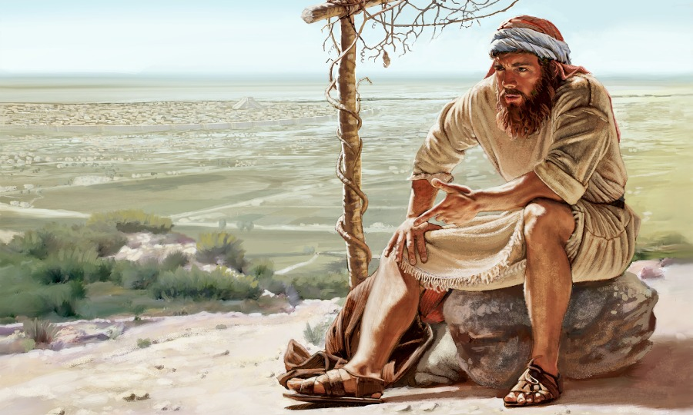
¿Es Correcto Tu Enojo?
Irritación personal
La importancia personal de Jonás fue minimizada
Celo por el honor de Dios
Los gentiles guardaron una muestra de ruina para su pueblo
Un patriotismo equivocado

Slide 6
Ira Reprendida
Una emoción que puede ser buena o mala.
Se dice que Dios está enojado con los hombres.
Marcos 3: 5
La ira no es justificable en desafío a Dios
La ira es inflamable cuando es causada por la salvación de los hombres.
La justicia de la ira es sospechosa cuando acompaña alguna humillación.
Filipenses 2: 1-8
Notes:
Mark 3:1-6 ESV Again he entered the synagogue, and a man was there with a withered hand. (2) And they watched Jesus, to see whether he would heal him on the Sabbath, so that they might accuse him. (3) And he said to the man with the withered hand, "Come here." (4) And he said to them, "Is it lawful on the Sabbath to do good or to do harm, to save life or to kill?" But they were silent. (5) And he looked around at them with anger, grieved at their hardness of heart, and said to the man, "Stretch out your hand." He stretched it out, and his hand was restored. (6) The Pharisees went out and immediately held counsel with the Herodians against him, how to destroy him.
Philippians 2:1-8 KJV If there be therefore any consolation in Christ, if any comfort of love, if any fellowship of the Spirit, if any bowels and mercies, (2) Fulfil ye my joy, that ye be likeminded, having the same love, being of one accord, of one mind. (3) Let nothing be done through strife or vainglory; but in lowliness of mind let each esteem other better than themselves. (4) Look not every man on his own things, but every man also on the things of others. (5) Let this mind be in you, which was also in Christ Jesus: (6) Who, being in the form of God, thought it not robbery to be equal with God: (7) But made himself of no reputation, and took upon him the form of a servant, and was made in the likeness of men: (8) And being found in fashion as a man, he humbled himself, and became obedient unto death, even the death of the cross.

Slide 7
Odio Contra el Bien Divino
Un hombre que ha encontrado misericordia puede negarlo a otros.
Egotismo
División
Medio santificado
Romanos 10: 19-21
El carácter de Dios es constante, los hombres pueden cambiar
No se aconseja la oración egoísta
Santiago 4: 3-12
Notes:
Romans 10:19-21 KJV But I say, Did not Israel know? First Moses saith, I will provoke you to jealousy by them that are no people, and by a foolish nation I will anger you. (20) But Esaias is very bold, and saith, I was found of them that sought me not; I was made manifest unto them that asked not after me. (21) But to Israel he saith, All day long I have stretched forth my hands unto a disobedient and gainsaying people.
James 4:3-12 KJV Ye ask, and receive not, because ye ask amiss, that ye may consume it upon your lusts. (4) Ye adulterers and adulteresses, know ye not that the friendship of the world is enmity with God? whosoever therefore will be a friend of the world is the enemy of God. (5) Do ye think that the scripture saith in vain, The spirit that dwelleth in us lusteth to envy? (6) But he giveth more grace. Wherefore he saith, God resisteth the proud, but giveth grace unto the humble. (7) Submit yourselves therefore to God. Resist the devil, and he will flee from you. (8) Draw nigh to God, and he will draw nigh to you. Cleanse your hands, ye sinners; and purify your hearts, ye double minded. (9) Be afflicted, and mourn, and weep: let your laughter be turned to mourning, and your joy to heaviness. (10) Humble yourselves in the sight of the Lord, and he shall lift you up. (11) Speak not evil one of another, brethren. He that speaketh evil of his brother, and judgeth his brother, speaketh evil of the law, and judgeth the law: but if thou judge the law, thou art not a doer of the law, but a judge. (12) There is one lawgiver, who is able to save and to destroy: who art thou that judgest another?

Slide 8
El Hermano Mayor Perdido Del Hijo Prodigo
Notes:
Luke 15:11-32 KJV And he said, A certain man had two sons: (12) And the younger of them said to his father, Father, give me the portion of goods that falleth to me. And he divided unto them his living. (13) And not many days after the younger son gathered all together, and took his journey into a far country, and there wasted his substance with riotous living. (14) And when he had spent all, there arose a mighty famine in that land; and he began to be in want. (15) And he went and joined himself to a citizen of that country; and he sent him into his fields to feed swine. (16) And he would fain have filled his belly with the husks that the swine did eat: and no man gave unto him. (17) And when he came to himself, he said, How many hired servants of my father's have bread enough and to spare, and I perish with hunger! (18) I will arise and go to my father, and will say unto him, Father, I have sinned against heaven, and before thee, (19) And am no more worthy to be called thy son: make me as one of thy hired servants. (20) And he arose, and came to his father. But when he was yet a great way off, his father saw him, and had compassion, and ran, and fell on his neck, and kissed him. (21) And the son said unto him, Father, I have sinned against heaven, and in thy sight, and am no more worthy to be called thy son. (22) But the father said to his servants, Bring forth the best robe, and put it on him; and put a ring on his hand, and shoes on his feet: (23) And bring hither the fatted calf, and kill it; and let us eat, and be merry: (24) For this my son was dead, and is alive again; he was lost, and is found. And they began to be merry. (25) Now his elder son was in the field: and as he came and drew nigh to the house, he heard musick and dancing. (26) And he called one of the servants, and asked what these things meant. (27) And he said unto him, Thy brother is come; and thy father hath killed the fatted calf, because he hath received him safe and sound. (28) And he was angry, and would not go in: therefore came his father out, and intreated him. (29) And he answering said to his father, Lo, these many years do I serve thee, neither transgressed I at any time thy commandment: and yet thou never gavest me a kid, that I might make merry with my friends: (30) But as soon as this thy son was come, which hath devoured thy living with harlots, thou hast killed for him the fatted calf. (31) And he said unto him, Son, thou art ever with me, and all that I have is thine. (32) It was meet that we should make merry, and be glad: for this thy brother was dead, and is alive again; and was lost, and is found.

Slide 9
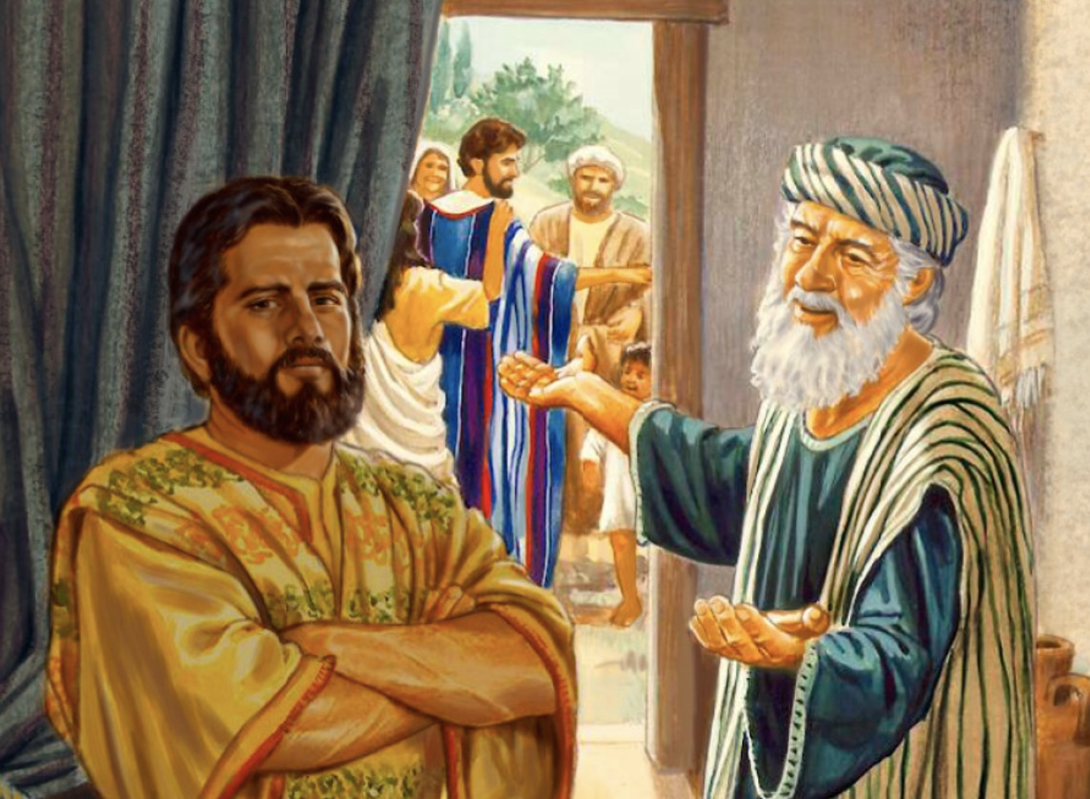
En Casa Pero Infeliz
Siempre en el trabajo, aislado. Tan olvidadizo del padre como el pródigo.
Parece crítico de la felicidad.
Un espíritu impío lo traiciona.
Se jacta de su fidelidad
Quería divertirse con sus amigos lejos del padre.
Él no se regocija por el hermano regresado
Que el corazón roto del hijo pródigo sea nuestro y no la crueldad del hermano mayor.

Slide 10
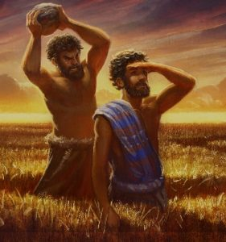
Note la Progresión
Gálatas 5: 19-21
Efesios 4: 31-32
Colosenses 3: 8-15
Santiago 1: 19-24
Notes:
Galatians 5:19-21 KJV Now the works of the flesh are manifest, which are these; Adultery, fornication, uncleanness, lasciviousness, (20) Idolatry, witchcraft, hatred, variance, emulations, wrath, strife, seditions, heresies, (21) Envyings, murders, drunkenness, revellings, and such like: of the which I tell you before, as I have also told you in time past, that they which do such things shall not inherit the kingdom of God.
Ephesians 4:31-32 KJV Let all bitterness, and wrath, and anger, and clamour, and evil speaking, be put away from you, with all malice: (32) And be ye kind one to another, tenderhearted, forgiving one another, even as God for Christ's sake hath forgiven you.
Colossians 3:8-15 KJV But now ye also put off all these; anger, wrath, malice, blasphemy, filthy communication out of your mouth. (9) Lie not one to another, seeing that ye have put off the old man with his deeds; (10) And have put on the new man, which is renewed in knowledge after the image of him that created him: (11) Where there is neither Greek nor Jew, circumcision nor uncircumcision, Barbarian, Scythian, bond nor free: but Christ is all, and in all. (12) Put on therefore, as the elect of God, holy and beloved, bowels of mercies, kindness, humbleness of mind, meekness, longsuffering; (13) Forbearing one another, and forgiving one another, if any man have a quarrel against any: even as Christ forgave you, so also do ye. (14) And above all these things put on charity, which is the bond of perfectness. (15) And let the peace of God rule in your hearts, to the which also ye are called in one body; and be ye thankful.
James 1:19-24 KJV Wherefore, my beloved brethren, let every man be swift to hear, slow to speak, slow to wrath: (20) For the wrath of man worketh not the righteousness of God. (21) Wherefore lay apart all filthiness and superfluity of naughtiness, and receive with meekness the engrafted word, which is able to save your souls. (22) But be ye doers of the word, and not hearers only, deceiving your own selves. (23) For if any be a hearer of the word, and not a doer, he is like unto a man beholding his natural face in a glass: (24) For he beholdeth himself, and goeth his way, and straightway forgetteth what manner of man he was.

Slide 11
La Lección
Eclesiastés 7: 9
No se apresure en su espíritu a enojarse, porque la ira se aloja en el corazón de los tontos.
Efesios 4: 26-27
Estar enojado y no pecar; no dejes que el sol se ponga sobre tu ira (27) y no le des oportunidad al diablo.

